Slide 1
Computation Creativity in Images

Slide 2
Automatic Anime Characters Creation with Generative Adversarial Networks
Problem Statement
Given a set of “Anime” images, create Anime Characters using GANs.
Dataset
Roughly 33,000 images of anime characters collected from the following websites: safebooru.org, www.getchu.com, danbooru.donmai.us .
The images were preprocessed and brought to a fixed dimension.
Tag Estimation : Illustration2Vec, a CNN based model is used to estimate tags from the images. 512 different tags were identified out of which 34 are used. These tags help in customized image creation and also for evaluation.
Model
A GAN-based model, DRAGAN proposed by Kodali et al. in “How to Train Your DRAGAN” is modified to solve the problem statement.
Evaluation Criteria
Manually: Using tags, precision is calculated using the images generated under a tag(one tag fixed and all the other labels sampled at random) as “predicted tag” and a manually judged tag as the “actual tag”.
Fréchet Inception Distance(FID): Using a pre-trained model, feature are extracted from real and fake samples and are approximated with 2 gaussian distributions; the Fréchet distance(Wasserstein-2 distance) between the two distributions gives a measure of the model quality.

Slide 3
Learning to Generate Images of Outdoor Scenes from Attributes and Semantic Layouts
Problem Statement: A model that takes its strength from the semantic layout of outdoor scenes and scene attributes integrated as conditioning variables able to generate realistic outdoor scene images under different conditions, e.g. daynight, sunny-foggy, with clear object boundaries.
Dataset : ADE20K dataset which includes 22, 210 images from a diverse set of indoor and outdoor scenes. This dataset
contains the annotated form of the images. (https://groups.csail.mit.edu/vision/datasets/ADE20K/)
Transient Attributes dataset contains 8, 571 outdoor scene images captured by 101 web-cams
(http://transattr.cs.brown.edu/)
Model : A layout conditioned GAN architecture namely AL-CGAN.(attribute and layout conditioned GAN)

Slide 4
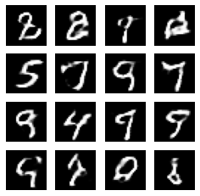
An attempt to understand GANs using MNIST dataset.
MNIST dataset contains the images of handwritten digits.
A vanilla GAN was trained using the dataset and then few new samples of images were generated which are as shown.
*Show Jupyter notebook for details.

Slide 6
Learning to Discover Cross-Domain Relations with Generative Adversarial Networks
Problem Statement
Learns to generate an image of one domain given an image of other domain using DiscoGAN. It learns to discover relations between different domains and using those discovered relations it transfers style from one domain to another while preserving key attribute.
Dataset
Edges2Handbags and Edges2Shoes dataset downloaded from below URL: http://efrosgans.eecs.berkeley.edu/pix2pix/datasets/
Model
Three different models were tried for training data- Standard GAN, GAN with reconstruction loss, DiscoGAN
First two baseline models faced 2 problems: a) Not Bijective b) Mode Collapse problem
DiscoGAN is the combination of 2 models. Each of the two coupled models learns the mapping from one domain to another, and also the reverse mapping to for reconstruction

Slide 7
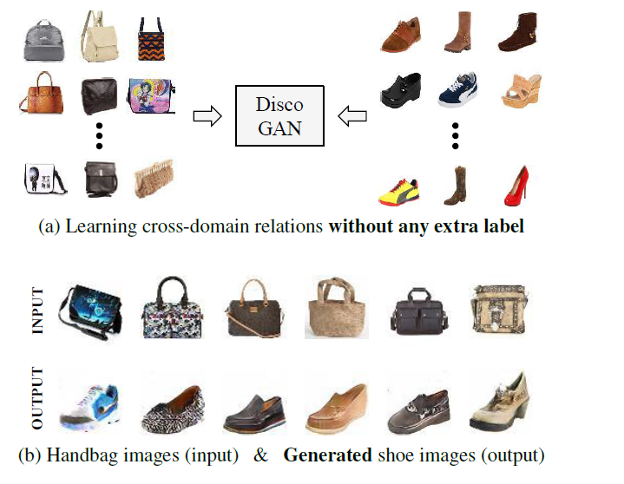

Slide 8
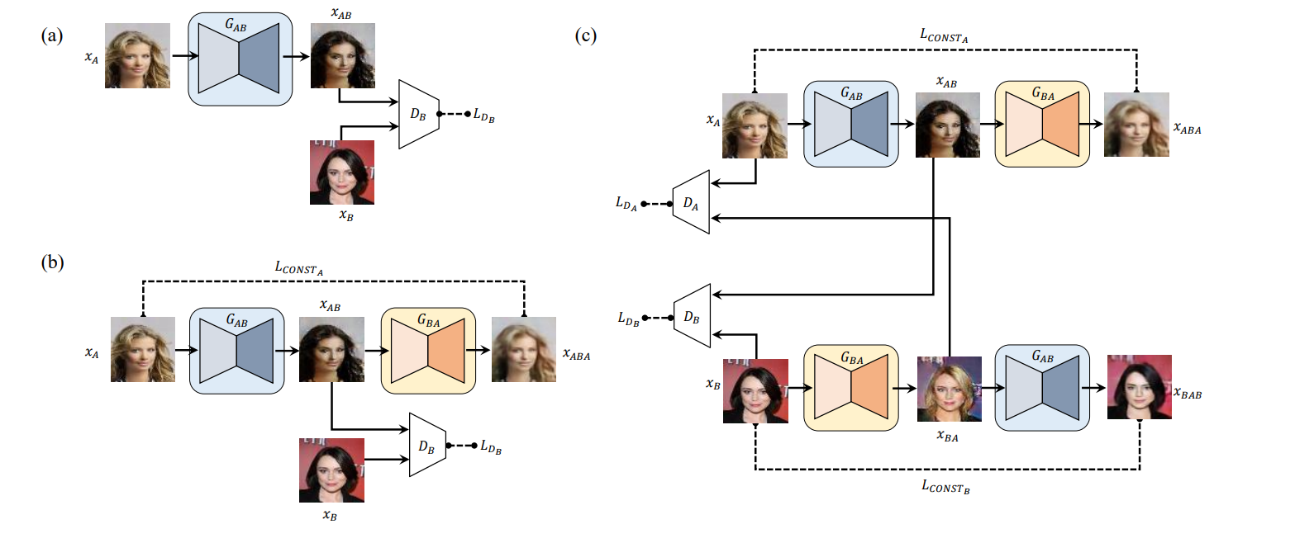
Model Architecture

